Slide 1
Canary
Hart Kornell, STL/MSTS, korneljm@nv.doe.gov, 805.681.2309

Slide 2
Multisensor platform
Canary is a multisensor, multicomms platform for persistent monitoring
It is inexpensive
It uses standard interfaces
It is designed to be easily extended via plugin daughtercard

Slide 3
Design goals
A flexible low-cost platform for CBRNE persistent monitoring
A zero-training end-user design
Assumed
Ignorance: We don’t know what people will want to do with it
Complex processing: Sense-making will be possible with high volumes of multisensor data

Slide 4
Implementation
Temperature, pressure, humidity, infrasound, sound, ultrasound, light, PIR, GPS, accelerometer, magnetometer
Standard software interfaces (APIs): Contiki OS, MQTT, C and other compilers
Standard hardware interface: I2C (serial and parallel)
Self-organizing: both proximal (100 meter) and distal (16 kilometer) meshes
Low-power: Nominal lifetime of eleven years unattended

Slide 5
Implementation (2)
Open source: Both hardware circuit board design and all firmware (Creative Commons License); chosen so that:
No license or registration fees
Canary apps and extensions can be proprietary with no legal entanglements
Inexpensive: About $150 ea
Future-proof, as far as we could: Uncommonly modular board design so sensors, memory, or CPG/GPU can be replaced without changing interfaces

Slide 6
Distribution
Canary has been distributed to developers at
National Laboratories: SNL, PNNL, ORNL, LANL, LBNL, SRNL
Universities: Berkeley, Davis, RPI, Virginia Tech, West Point
To operational mission teams at RSL and in the IC

Slide 7
Integration
Canaries have been/are being integrated with
Chemical sensing
Vehicle tracking
Vehicle identification
High-speed cameras
A validation of ‘ignorance-based design:’ we never thought of the light sensor on the Canaries being used as a visual tachometer

Slide 8
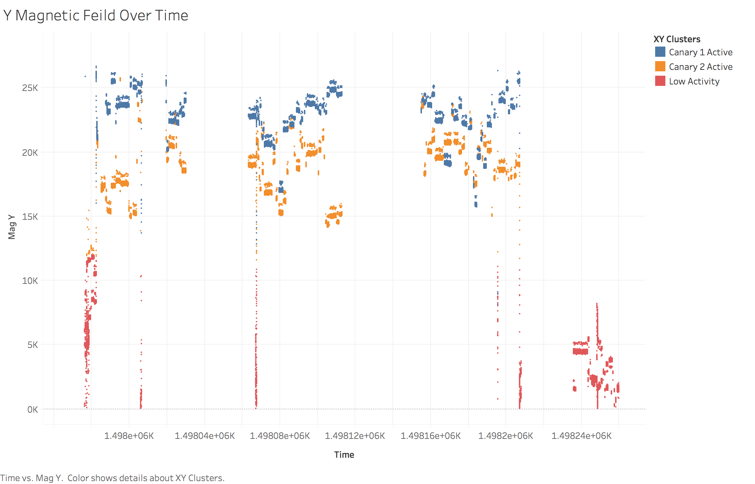
Sample application
Can we tell what’s going on inside the building from outside?
Two Canaries at the Lawrence Berkeley 88-Inch Cyclotron
Power cycling clearly present from outside the containment

Slide 9
Prospects
The need for persistent monitoring of CBRNE threats is compelling
Canary is a suitable platform
Discussions regarding joint sponsorship — DTRA, DNDO, DOE DNN R&D — are ongoing for a major urban nuclear/radiological monitoring network involving many hundreds of Canaries
Many other possibilities are open

Slide 10
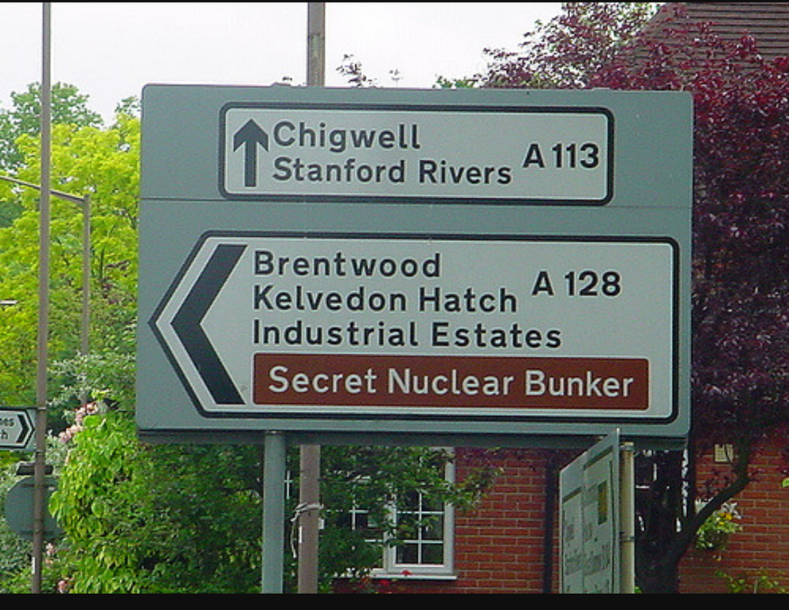
Conclusion
A useful platform was built on a risibly small budget
Distribution is broad
The LUNARCAT investment in Canary will (we hope) continue to pay dividends in our mission space for the next decade

